Slide 1
dd vs ddrescue tool
- Srinivas Garapati

Slide 2
Overview
Introduction
Basic Concept
General User Commands used
Usage of dd tool
Usage of ddrescue tool
Summary
References

Slide 3
Introduction
dd
ddrescue
dd is a tool that is used to make a disk image.
Designed for Unix and Unix like operating systems.
dd tool uses simple algorithm and has no fancy add ons.
dd tool is simple and minimal.
ddrescue is a data recovery tool.
Program written in c++ and available for most Linux distributions.
ddrescue uses sophisticated algorithm to copy data.
Ddrescue is not a derivate of dd

Slide 4
Basic Concepts
dd
ddrescue
If there is a bad sector it fills it with zeroes.
dd does not take into account if the data is damaged.
Easy to compress the disk image using gzip.
dd tool output is a compressed image of the disk and uses less space.
fill in those areas with data from subsequent runs.
dd rescue works better if there are broken data sources.
ddrescue needs an external software like fusecompress.
It takes up more space.

Slide 5
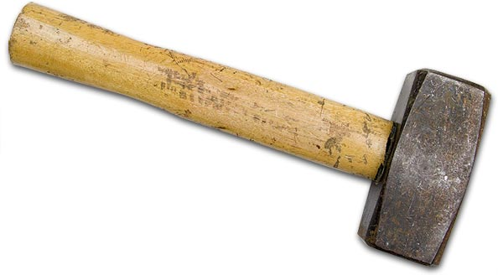
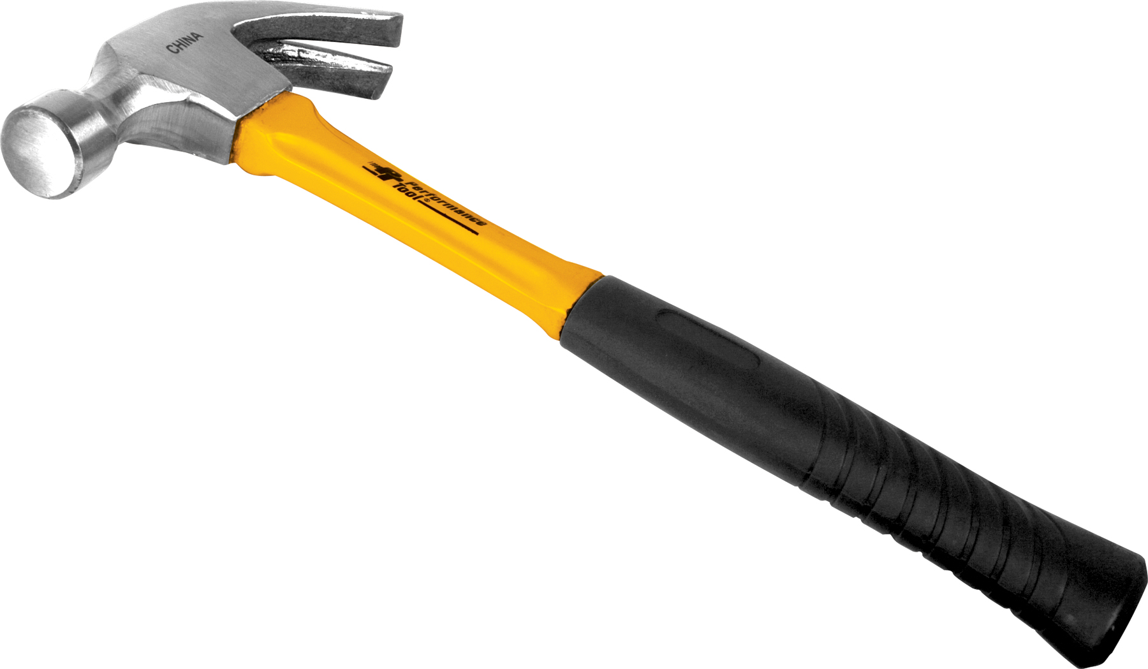
dd
ddrescue
dd tool is like a simple hammer.
It is simple and can perform jobs if there are no errors in the files.
ddrescue tool is like a claw performs similar functions like dd but can remove nails as well.
ddrescue provides with the best chance of recovering but at an expense of time and cost.

Slide 6
General User Commands used in dd
Syntax: #dd if=[file] of=[file] bs=[block size]
if=read from FILE
of=write to FILE
skip=skip the number of blocks mentioned at the start
bs=read and write up to the number of bytes mentioned
conv=convert the file as per the comma separated symbol list
For more: http://man7.org/linux/man-pages/man1/dd.1.html

Slide 7
General User Commands used in ddrescue
Syntax: #ddrescue [options] inputfile outfile [mapfile]
General Options used:
-h = Print an informative help message describing the options and exit
-v = Print the version number of ddrescue on the standard output and exit
-a bytes = Minimum read rate of good non-tried areas
-b bytes = Sector size of input device in bytes (Usually 512)
-c = number of sectors to copy
-v = Verbose mode
For more: https://www.gnu.org/software/ddrescue/manual/ddrescue_manual.html

Slide 8
Usage of dd tool -1
Backup entire hard drive to another drive:
dd if=/dev/sda of=/dev/sdb bs=4096 conv=noerror
If -input file
of -output file
bs -block size
noerror -allows the tool to continue to copy the data even though it encounter any errors
Creating a disk image:
dd if=/dev/sda of=/tmp/sdadisk.img

Slide 9
Usage of dd tool -2
Creating a compressed disk image
dd if=/dev/sda | gzip >/tmp/sdadisk.img.gz
Restoring hard disk image
dd if=/tmp/sdadisk.img of=/dev/sda
Restoring compressed image
gzip –dc /tmp/sdadisk.img.gz | dd of=/dev/sda
Clone one partition to another
dd if=/dev/sda1 of=/dev/sdb1 bs=4096 conv=noerror

Slide 10
Usage of ddrescue tool
Creating an image of a disk:
# ddrescue -d -r3 /dev/sda test.img test.logfile
d -direct disk access and ignore the kernel’s cache
r3 –ddrescue tries for 3 attempts to retrieve bad sectors
Restoring an image to new disk:
#ddrescue -f test.img /dev/sda restore.logfile

Slide 11
Summary
Both dd and ddrescue tools can be used for data recovery.
Compared to ddrescue is tool that has more options than dd whereas dd is a simple and easy to use tool.
ddrescue produces better results in the cases if there are bad sectors or errors in the files to be retrieved but lacks in the case of time and cost.

Slide 12
References
https://en.wikipedia.org/wiki/Dd_(Unix_software)
https://en.wikipedia.org/wiki/Ddrescue
https://www.gnu.org/software/ddrescue/manual/ddrescue_manual.html
http://man7.org/linux/man-pages/man1/dd.1.html
https://www.technibble.com/guide-using-ddrescue-recover-data/
http://linoxide.com/linux-command/linux-dd-command-create-1gb-file/

